Slide 1
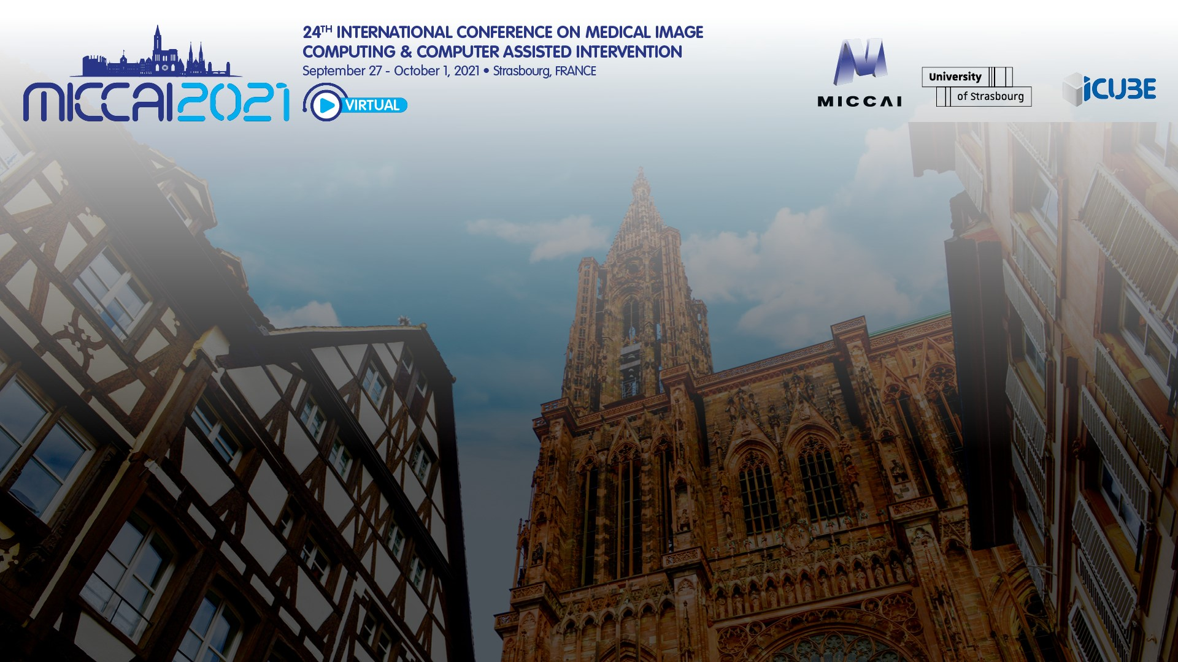
An Efficient Tracker for Thyroid Nodule Detection and Tracking during Ultrasound Screening
Ting Liu, Xing An, Bin Lin, Yanbo Liu, Wenlong Xu, Yuxi Liu, Longfei Cong, and Lei Zhu^{()}
Shenzhen Mindray Bio-Medical Electronics, Co., Ltd., Shenzhen, China

Slide 2
Content
1. Background
2. Methods
3. Results
4. Conclusion

Slide 3
1. Background

Slide 4
Background Clinical Background
Common in clinic
Incidence rising rapidly throughout the world
Large amounts of ultrasound videos
time-consuming
great challenges for doctors
Unclear boundary & similarity between nodules and tissues
false detection

Slide 5
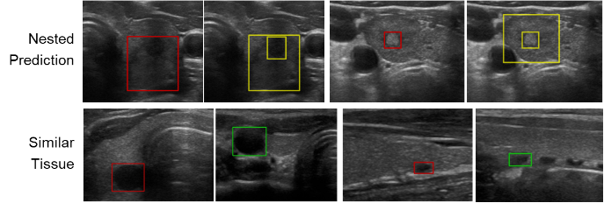
Background Challenges
less attention is paid to ultrasound videos
Nested predictions still remain after post-processing
Misdetection of normal tissues
Red: the ground truth
Yellow: nested prediction
Green: normal tissues that are similar to nodules

Slide 6
2. Methods

Slide 7
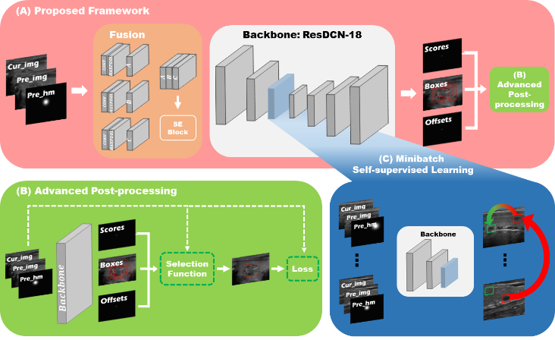
Methods Network Architecture
Inputs:
The current frame
The previous frame
The heatmap generated from objects in the prior frame
Outputs:
The predicted rectangles
The classification probability of each prediction
The center offset of tracked boxes in adjacent frames

Slide 8
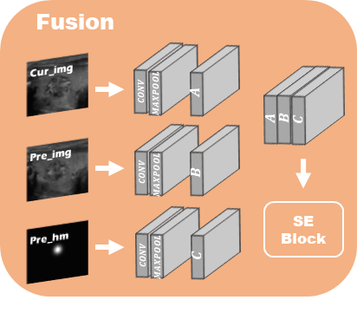
Methods Fusion Module
To better fuse the feature of inputs
Extract the features of each input
Squeeze-and-excitation (SE) block
learn the importance of each input

Slide 9
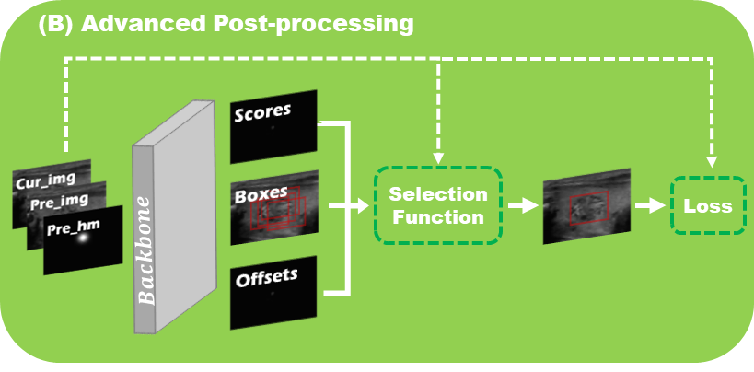
Methods Advanced Post-processing Module
Potential of technology development needs to be harnessed to respond industry challenge

Slide 10
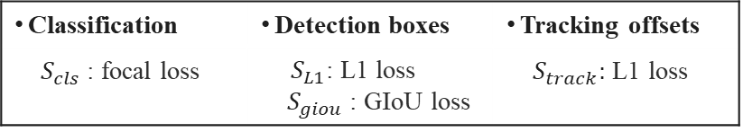
Methods Advanced Post-processing Module
Selection Function
$$S= λ_{cls}∗S_{cls}+ λ_{L1}∗S_{L1}+λ_{giou}∗S_{giou}+λ_{track}∗S_{track}$$
Classification | Detection boxes | Tracking offsets
$S_{cls}$ : focal loss | $S_{L1}$: L1 loss $S_{giou}$ : GIoU loss | $S_{track}:$ L1 loss
Loss Function
Potential of technology development needs to be harnessed to respond industry challenge
$$L_{dt}= μ_{cls}∗L_{cls}+ μ_{L1}∗L_{L1}+μ_{giou}∗L_{giou}+μ_{track}∗L_{track}$$

Slide 11
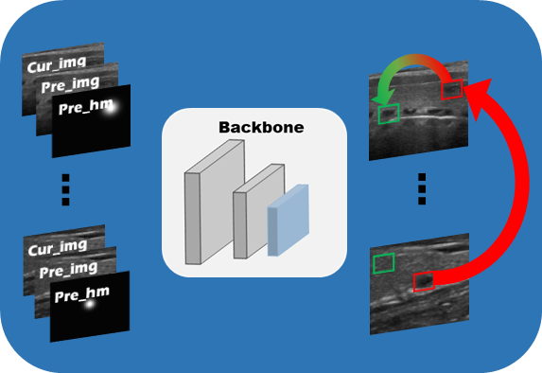
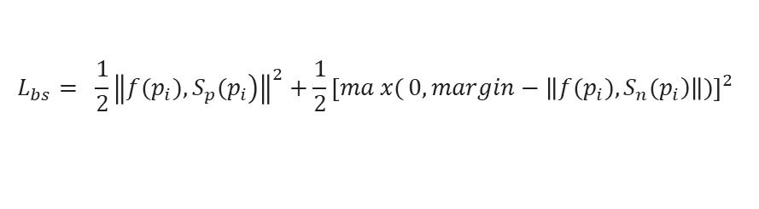
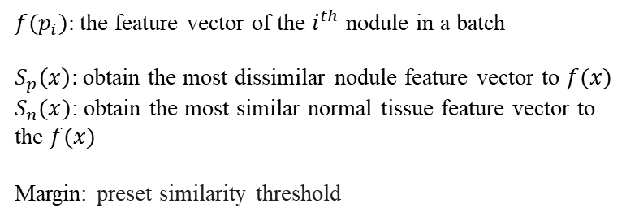
Methods Minibatch Self-supervised Learning Module
Batch-based similarity loss function
$$L_{bs}= \frac{1}{2}{\left\|\left.{f(p}_{i}),S_{p}(p_{i}\right)\right\|}^{2}+\frac{1}{2}{\left[max{(}0,margin−\left\|\left.{f(p}_{i}),S_{n}(p_{i}\right)\right\|)\right]}^{2}$$
${f(p}_{i}):$ the feature vector of the $i^{th}$ nodule in a batch
$S_{p}\left(x\right):$obtain the most dissimilar nodule feature vector to $f(x)$
$S_{n}(x)$: obtain the most similar normal tissue feature vector to the $f(x)$
Margin: preset similarity threshold

Slide 12
Methods Experiments
1555 movies, 13,314 images
Annotation
five doctors & an expert
Nodule size (462 to 232,672 pixels, mean: 29,979 pixels)
small (<1503 pixels), middle (1503 pixels, 6923 pixels) and large (＞6923 pixels)
Traing set (80%)
movies: 1244; images: 10597
Validation set (10%)
movies: 155; images: 1363
Testing set (10%):
movies: 156; images: 1354
Potential of technology development needs to be harnessed to respond industry challenge

Slide 13
3. Results

Slide 14
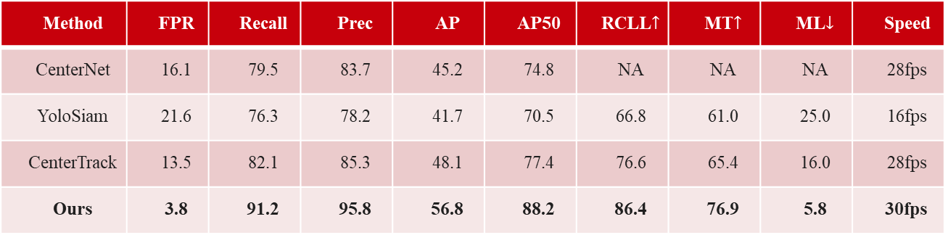
Results Quantitative Analysis
Table 1. Performance comparison on the thyroid dataset (%).
Method | FPR | Recall | Prec | AP | AP50 | RCLL$↑$ | MT$↑$ | ML$↓$ | Speed
CenterNet | 16.1 | 79.5 | 83.7 | 45.2 | 74.8 | NA | NA | NA | 28fps
YoloSiam | 21.6 | 76.3 | 78.2 | 41.7 | 70.5 | 66.8 | 61.0 | 25.0 | 16fps
CenterTrack | 13.5 | 82.1 | 85.3 | 48.1 | 77.4 | 76.6 | 65.4 | 16.0 | 28fps
Ours | 3.8 | 91.2 | 95.8 | 56.8 | 88.2 | 86.4 | 76.9 | 5.8 | 30fps

Slide 15
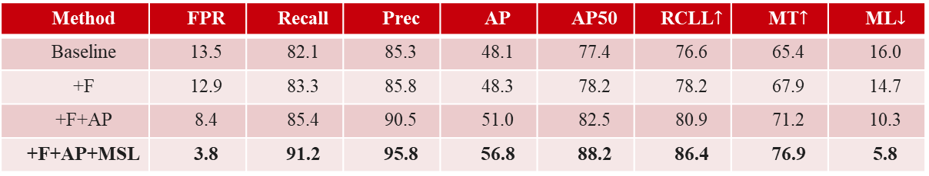
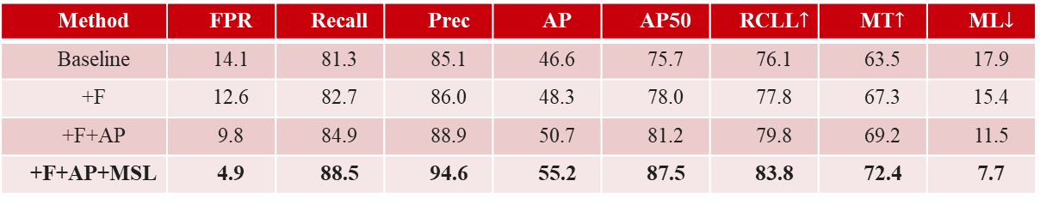
Results Quantitative Analysis
Table 2. Results of ablation studies based on pretrained ResDCN-18 (%)
Method | FPR | Recall | Prec | AP | AP50 | RCLL$↑$ | MT$↑$ | ML$↓$
Baseline | 13.5 | 82.1 | 85.3 | 48.1 | 77.4 | 76.6 | 65.4 | 16.0
+F | 12.9 | 83.3 | 85.8 | 48.3 | 78.2 | 78.2 | 67.9 | 14.7
+F+AP | 8.4 | 85.4 | 90.5 | 51.0 | 82.5 | 80.9 | 71.2 | 10.3
+F+AP+MSL | 3.8 | 91.2 | 95.8 | 56.8 | 88.2 | 86.4 | 76.9 | 5.8
Table 3. Results of ablation studies based on DLA-34 (%)
Method | FPR | Recall | Prec | AP | AP50 | RCLL$↑$ | MT$↑$ | ML$↓$
Baseline | 14.1 | 81.3 | 85.1 | 46.6 | 75.7 | 76.1 | 63.5 | 17.9
+F | 12.6 | 82.7 | 86.0 | 48.3 | 78.0 | 77.8 | 67.3 | 15.4
+F+AP | 9.8 | 84.9 | 88.9 | 50.7 | 81.2 | 79.8 | 69.2 | 11.5
+F+AP+MSL | 4.9 | 88.5 | 94.6 | 55.2 | 87.5 | 83.8 | 72.4 | 7.7
Potential of technology development needs to be harnessed to respond industry challenge

Slide 16
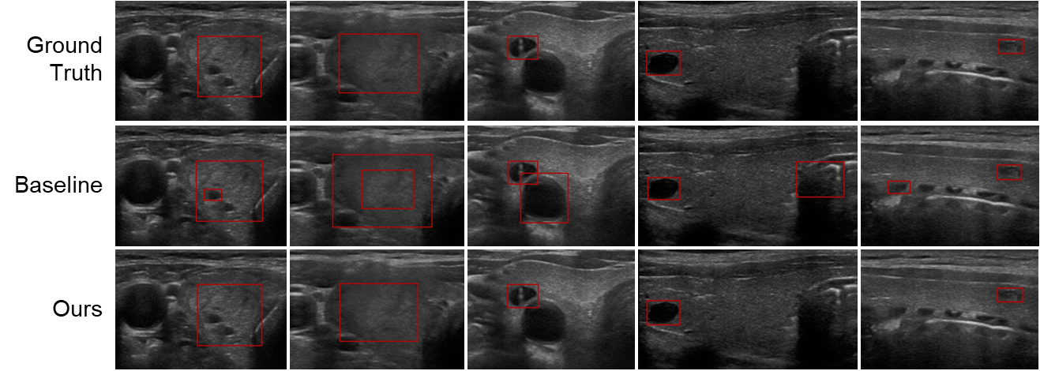
Results Qualitative Comparison

Slide 17
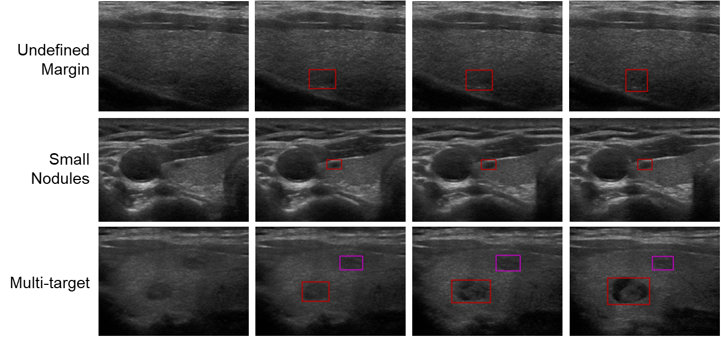
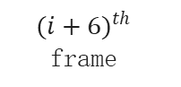
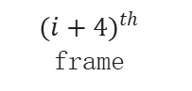
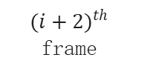
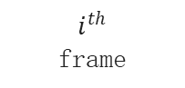
Results Qualitative Comparison
$i^{th}$
frame
$$({i+2)}^{th}$$
frame
$$({i+4)}^{th}$$
frame
$${(i+6)}^{th}$$
frame

Slide 18
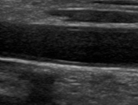
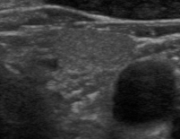
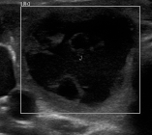
Results Qualitative Comparison
Two nodules on a frame
Nodule with unclear boundray
Big nodule
Potential of technology development needs to be harnessed to respond industry challenge

Slide 19
4. Conclusion

Slide 20
Conclusion Conclusion
Fusion module
combine features of previous and current frames
acquire better detection and tracking result
Advanced post-processing mechanism
train the model to select the optimal prediction
boost the detection accuracy
Minibatch self-supervised learning module
enhance the ability of distinguishing nodules from similar tissues
reduce the false positive rate
Potential of technology development needs to be harnessed to respond industry challenge

Slide 21

THANK YOU
company presentation｜confidential

